Slide 1
2.3 Functions

Slide 2
On to section 2.3… Functions
From calculus, you are familiar with the concept of a real-valued function f, which assigns to each number x∈R a particular value y=f(x), where y∈R .
But, the notion of a function can also be naturally generalized to the concept of assigning elements of any set to elements of any set. (Also known as a map)

Slide 3
Function: Formal Definition
For any sets A, B, we say that a function f from (or “mapping”) A to B (f:A→B) is a particular assignment of exactly one element f(x)∈B to each element x∈A.
Some further generalizations of this idea:
A partial (non-total) function f assigns zero or one elements of B to each element x∈A.
Functions of n arguments; relations (ch. 6).

Slide 4
Functions
Definition: Let A and B be nonempty sets. A function (mapping, transformation) f from A to B, denoted f : A→ B, is a subset of A×B such that
∀x[x ∈A→∃y[y ∈B∧ < x, y >∈ f ]]
and
[< x, y₁ >∈ f ∧ < x, y₂ >∈ f ]→ y₁ = y₂

Slide 5
Graphical Representations
Functions can be represented graphically in several ways:
f
A
B
•
•
f
•
•
•
•
•
y
a
b
•
•
•
•
x
A
B
Bipartite Graph
Plot
Like Venn diagrams

Slide 6
Functions f : A→ B
A is called the domain（定义域）
B is called the codomain （陪域）.
If f(x) = y
y is called the image像(value值) of x under f
x is called a preimage源像(argument) of y
The range （值域） of f is the set of all images of points in A under f. It is denoted by f(A).
If S is a subset of A then
f(S) = {f(s) | s in S}.

Slide 7
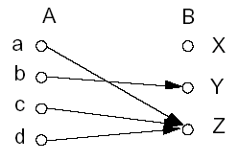
Example
f(a) = Z
the image of d is Z
the domain of f is A = {a, b, c, d}
the codomain is B = {X, Y, Z}
f(A) = {Y, Z}
the preimage of Y is b
the preimages of Z are a, c and d
f({c,d}) = {Z}

Slide 8
Range versus Codomain
The range of a function might not be its whole codomain.
The codomain is the set that the function is declared to map all domain values into.
The range is the particular set of values in the codomain that the function actually maps elements of the domain to.

Slide 9
Range vs. Codomain – Example
Suppose I declare to you that: “f is a function mapping students in this class to the set of grades {A,B,C,D,E}.”
At this point, you know f’s codomain is: __________, and its range is ________.
Suppose the grades turn out all As and Bs.
Then the range of f is _________, but its codomain is __________________.
{A,B,C,D,E}
unknown!
{A,B}
still {A,B,C,D,E}!

Slide 10
Operators (general definition)
An n-ary operator over (or on) the set S is any function from the set of ordered n-tuples of elements of S, to S itself.
E.g., if S={T,F}, ¬ can be seen as a unary operator, and ∧,∨ are binary operators on S.
Another example: ∪ and ∩ are binary operators on the set of all sets.

Slide 11
Constructing Function Operators
If • (“dot”) is any operator over B, then we can extend • to also denote an operator over functions f:A→B.
E.g.: Given any binary operator •:B×B→B, and functions f,g:A→B, we define (f • g):A→B to be the function defined by: ∀a∈A, (f • g)(a) = f(a)•g(a).

Slide 12
Function Operator Example
Examples:
+(plus), ×(times) are binary operators.
We can also add and multiply functions f,g: R→ R:
(f+g):R → R, where (f+g)(x)= f(x)+g(x).
(f×g):R → R, where (f×g)(x)= f(x)× g(x).
Examples:
f(x)=x², g(x)=2x+1
(f+g)(x)=f(x)+ g(x)= x²+2x+1
(f×g)(x)=f(x)× g(x)= x² (2x+1)

Slide 13
Special types of Functions
Injections（内射）
One-to-one （一对一）
Surjections （满射）
onto （上的）
Bijections （双射）
One-to-one and onto
One-to-one correspondence （一一对应）

Slide 14
One-to-One Functions
A function is one-to-one (1-1), or injective, or an injection, iff every element of its range has only 1 pre-image.
Formally: given f:A→B, “f is injective” :≡ (¬∃x,y: x≠y ∧ f(x)=f(y)).
Only one element of the domain is mapped to any given one element of the range.
Domain & range have same cardinality. What about codomain?
Memory jogger: Each element of the domain is injected into a different element of the range.
Compare “each dose of vaccine is injected into a different patient.”
May Be
Larger

Slide 15
One-to-One Illustration
Bipartite (2-part) graph representations of functions that are (or not) one-to-one:
•
•
•
•
•
•
•
•
•
•
•
•
•
•
•
•
•
•
•
•
•
•
•
•
•
•
•
Not one-to-one
Not even a function!
One-to-one

Slide 16
Sufficient Conditions for 1-1ness
For functions f over numbers, we say:
f is strictly (or monotonically) increasing iff x>y → f(x)>f(y) for all x,y in domain;
f is strictly (or monotonically) decreasing iff x>y → f(x)<f(y) for all x,y in domain;
If f is either strictly increasing or strictly decreasing, then f is one-to-one. E.g. x³
Converse is not necessarily true. E.g. 1/x

Slide 17
Onto (Surjective) Functions
A function f:A→B is onto or surjective or a surjection iff its range is equal to its codomain (∀b∈B, ∃a∈A: f(a)=b).
Think: An onto function maps the set A onto (over, covering) the entirety of the set B, not just over a piece of it.
E.g., for domain & codomain R, x³ is onto, whereas x² isn’t. (Why not?)

Slide 18
Illustration of Onto
Some functions that are, or are not, onto their codomains:
•
•
•
•
•
•
•
•
•
•
•
•
•
•
•
•
•
•
•
•
•
•
•
•
•
•
•
•
•
•
•
•
•
•
•
Onto (but not 1-1)
Not Onto (or 1-1)
Both 1-1 and onto
1-1 but not onto

Slide 19
Bijections
A function f is said to be a one-to-one correspondence, or a bijection, or reversible, or invertible, iff it is both one-to-one and onto.

Slide 20
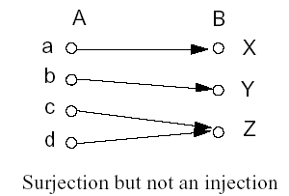
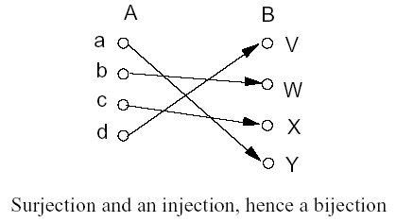
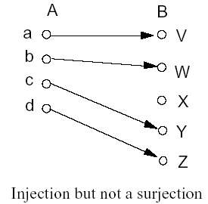
Examples

Slide 21
Examples:
Let
A = B =R
Determine which are injections, surjections, bijections:
f(x) = x,
f(x) = x²,
f(x) = x³,
f(x) = | x |

Slide 22

多选题
1分
Let A = B =R
Determine which are injections？
A
f(x) = x
B
f(x) = x²
C
f(x) = x³
D
f(x) = | x |
提交

Slide 23
多选题
1分
Let A = B =R
Determine which are surjections ？
A
f(x) = x
B
f(x) = x²
C
f(x) = x³
D
f(x) = | x |
提交

Slide 24
多选题
1分
Let A = B =R
Determine which are bijections ？
A
f(x) = x,
B
f(x) = x²,
C
f(x) = x³,
D
f(x) = | x |
提交

Slide 25
Correspondence Principle
If two finite sets can be placed into 1-1 onto correspondence, then they have the same size.

Slide 26
The Identity Function
For any domain A, the identity function I:A→A (variously written, I_{A}, 1, 1_{A}) is the unique function such that ∀a∈A: I(a)=a.
Some identity functions you’ve seen:
+ing 0, ·ing by 1, ∧ing with T, ∨ing with F, ∪ing with ∅, ∩ing with U.
Note that the identity function is always both one-to-one and onto (bijective).

Slide 27
Identity Function Illustrations
The identity function:
•
•
•
y
y = I(x) = x
•
•
•
•
•
•
Domain and range
x

Slide 28
Inverse Functions
Definition: Let f be a bijection from A to B. Then the inverse of f, denoted f⁻¹, is the function from B to A defined as
f⁻¹(y) = x iff f(x) = y
f is said to be invertible(可逆的)

Slide 29
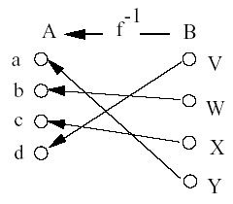
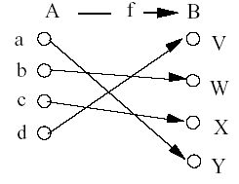
Inverse Functions
Note: No inverse exists unless f is a bijection.

Slide 30
Inverse Functions
Definition:
Let S be a subset of B.
Then
f⁻¹(S) = {x | f(x) ∈ S}
逆函数的值域 f⁻¹(S)为x的集合
x满足条件为：x的像 f(x)属于值域S
f⁻¹(f(x))=x

Slide 31
Composition
Definition: Let f: B→C, g: A→B. The composition of f with g, denoted f ◦ g, is the function from A to C defined by
f ◦ g(x) = f(g(x))

Slide 32
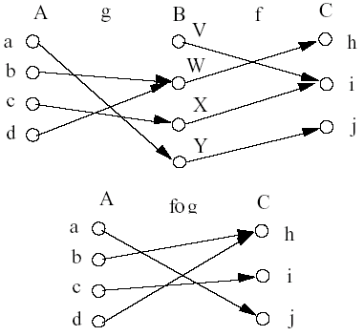
Composition

Slide 33
Composition
If
f(x) = x²
g(x) = 2x + 1
Then
f(g(x)) = (2x+1)²
g(f(x)) = 2x² + 1
The commutative law does not hold for the composition of functions.

Slide 34
Composition
Let
f: A→B
g: B→C
h: C→D
Then
(h ◦□g) ◦ f = h ◦ (g ◦ f)
The proof is same as in relation’s associativity
The associative law holds for the composition of functions.

Slide 35
Exercise
Let
A = B = C = R
f : A→B, g: B→ C
f(a)=a-1
g(b)=b² .
Find
(f□◦ g)(2)
(g ◦ f)(2)
(g ◦ f)(x)
(f ◦ g)(x)
(g ◦ g)(y)
(f□◦ f)(y)

Slide 36
Theorem
Let f:A→B be any function. Then
1_{B}□◦ f = f
f□◦ 1_{A} = f
If f is a one-to-one correspondence between A and B, then
f⁻¹ ◦ f = 1_{A}
f□◦ f⁻¹ = 1_{B}

Slide 37
Proof
For all a in Dom(f)
(1_{B}□◦ f)(a) = 1_{B}(f(a)) = f(a), Thus 1_{B}□◦ f = f.
(f □◦ 1_{A})(a)= f(1_{A}(a)) = f(a), so f □◦ 1_{A} = f.
For all a in A,
1_{A}(a)=a=f⁻¹(f(a))=(f⁻¹□◦ f)(a), Thus 1_{A}=f⁻¹□◦ f
For all b in B,
1_{B}(b)=b=f(f⁻¹(b))=(f □◦ f⁻¹)(b), Thus 1_{B}=f □◦ f⁻¹
Note: b=f(a) is equivalent to the a=f⁻¹(b)

Slide 38
Graphs of Functions
We can represent a function f:A→B as a set of ordered pairs {(a,f(a)) | a∈A}.
Note that ∀a, there is only 1 pair (a,b).
Later (ch.6): relations loosen this restriction.
For functions over numbers, we can represent an ordered pair (x,y) as a point on a plane.
A function is then drawn as a curve (set of points), with only one y for each x.
← The function’s graph.

Slide 39
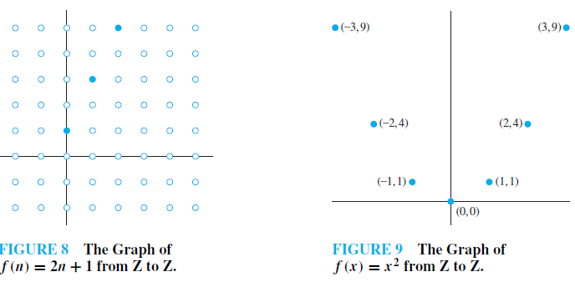
Example 26
Example 27

Slide 40
Floor and ceiling function
The floor function, denoted f (x) = ⎣x⎦ or f(x) = floor(x), is the largest integer less than or equal to x.
The ceiling function, denoted f (x) = ⎡x⎤ or f(x) = ceiling(x), is the smallest integer greater than or equal to x.
Examples: ⎣3.5⎦ = 3, ⎡3.5⎤ = 4.
Note: the floor function is equivalent to truncation for positive numbers.
Application:
Truncation used in computer network and communication network

Slide 41
Visualizing Floor & Ceiling
Real numbers “fall to their floor” or “rise to their ceiling.”
Note that if x∉Z, ⎣−x⎦ ≠ − ⎣x⎦ & ⎡−x⎤ ≠ − ⎡x⎤
Note that if x∈Z, ⎣x⎦ = ⎡x⎤ = x.
3
.
2
⎡1.6⎤=2
.
1.6
.
1
⎣1.6⎦=1
0
.
−1
⎡−1.4⎤= −1
.
−1.4
.
−2
.
.
.
⎣−1.4⎦= −2
−3
−3
⎡−3⎤=⎣−3⎦= −3

Slide 42
Plots with floor/ceiling
Note that for f(x)=⎣x⎦, the graph of f includes the point (a, 0) for all values of a such that a≥0 and a<1, but not for the value a=1.
We say that the set of points (a,0) that is in f does not include its limit or boundary point (a,1).
Sets that do not include all of their limit points are generally called open sets.
In a plot, we draw a limit point of a curve using an open dot (circle) if the limit point is not on the curve, and with a closed (solid) dot if it is on the curve.

Slide 43
Plots with floor/ceiling: Example
Plot of graph of function f(x) = ⎣x/3⎦:
f(x)
Set of points (x, f(x))
+2
−3
+3
x
−2

Slide 44
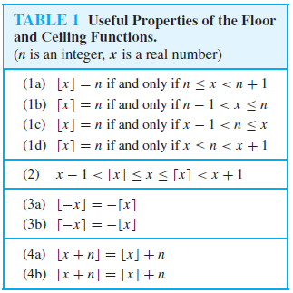
Properties of the floor and ceiling functions
Table 1

Slide 45
Example
Prove that if x is a real number, then
Proof: Let x=n+ε (0≤ ε<1)
1) Case 1: 0≤ ε<1/2, ⎣2x⎦= ⎣2n+2ε⎦=2n
⎣x⎦= ⎣n+ε⎦=n, ⎣x+1/2⎦= ⎣n+ε+1/2⎦=n
show ⎣2x⎦= ⎣x⎦+ ⎣x+1/2⎦
2) Case 2: 1/2≤ ε<1, ⎣2x⎦= ⎣2n+2ε⎦=2n+1
⎣x⎦= ⎣n+ε⎦=n, ⎣x+1/2⎦= ⎣n+ε+1/2⎦=n+1
show ⎣2x⎦= ⎣x⎦+ ⎣x+1/2⎦

Slide 46
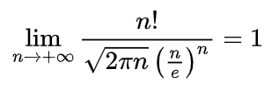
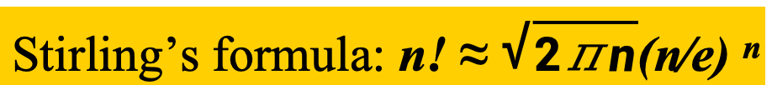
Factorial function
Definition：
f: ->⁺ f(n)=n!
n! grows extremely rapidly as n grows.
Stirling’s formula: n! ≈ $\sqrt{2\text{π}n}$(n∕e) ^{n}

Slide 47
Characteristic Functions(特征函数)
Let A be a subset of the universal set U={u₁, u₂ , u₃ , ..., u_{n} }.
The characteristic function of A is defined as a function from U to {0,1} by the following:

Slide 48
Characteristic Functions
Example
if
A={4, 7, 9}
U={1, 2, 3, …, 10},
then
f_{A}(2)=0,
f_{A}(4)=1,
f_{A}(7)=1,
f_{A}(12) is undefined.
Note: f_{A} is onto but not one to one

Slide 49
Mod-n Functions(模n函数)
Let f_{n} is a function from the nonnegative integers to the set {0, 1, 2, 3,…, n-1}.
For a fixed n, any nonnegative integer z can be written as
z=kn+r with 0≤r<n ,
Then
f_{n}(z)=r or z ≡ r (mod n).
Note: f_{n} is onto but not one to one
Example:
Let f₅(x)=y or y= x mod 5 , then f₅(7)=? , f₅(9)=? , f₅(20)=?

Slide 50
Examples
The sets A and B in the definition of a function need not be sets of numbers.
Let A be a finite set and define l: A*→Ζ as l(w) is the length of the string w
Let B be a finite subset of the universal set U and define pow(B) to be the power set of B. Then pow is a function from V, the power set of U, to the power set of V.

Slide 51
Partial Functions
A partial function f from a set A to a set B is an assignment to each element a in a subset of A, called the domain of definition of f , of a unique element b in B.
The sets A and B are called the domain and codomain of f , respectively.
We say that f is undefined for elements in A that are not in the domain of definition of f .
When the domain of definition of f equals A, we say that f is a total function.

Slide 52
EXAMPLE 34
The function f : Z → R where f(n) = is a partial function from Z to R where the domain of definition is the set of nonnegative integers.
f is undefined for negative integers.

Slide 53
Review of §2.3 (Functions)
Function variables: f, g, h…
Function Notation: f:A→B, f(a), f(A)
Terms:
domain, codomain, image, preimage, range,
one-to-one (injection), onto (surjection), one-to-one correspondence (bijection),
strictly (in/de)creasing, identity, inverse, composite
Function operations: +, -, ×, I_{A}, f⁻¹, □
Special Functions:
Floor and ceiling, Factorial function, Characteristic function, Mod-n function, Partial function…

Slide 54
Please feel free
to ask questions!
((( )))

Slide 55
Homework
§2.3
20, 24, 33, 66

